Slide 1


SPLITWISE RESTAURANT BILLING SYSTEM
BY: Taimoor Riaz

Slide 2
TABLE OF CONTENTS
01
INTRODUCTION
02
FEATURE
03
Video

Slide 3

01
INTRODUCTION
This program helps users:
Select food items from a menu.
Calculate total cost and split the bill among members.
Choose a payment method (cash or card with discount).
Reserve a seat from available options.
Generate a detailed bill receipt
.

Slide 4
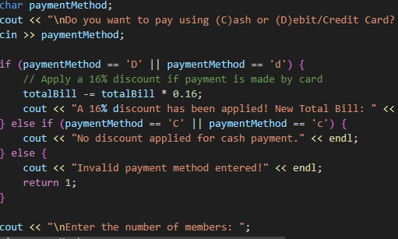
FEATURES OF PROGRAM
MENU SELECTION: Users select food items and specify quantities.
Bill Calculation: Calculates total cost based on items selected.
Discount System: 16% discount on card payments.
Bill Splitting: Divides total bill equally among members.
Seat Reservation: Displays available seats and allows booking.
Bill Slip Generation: Displays ordered items, cost, and amount owed.

Slide 5
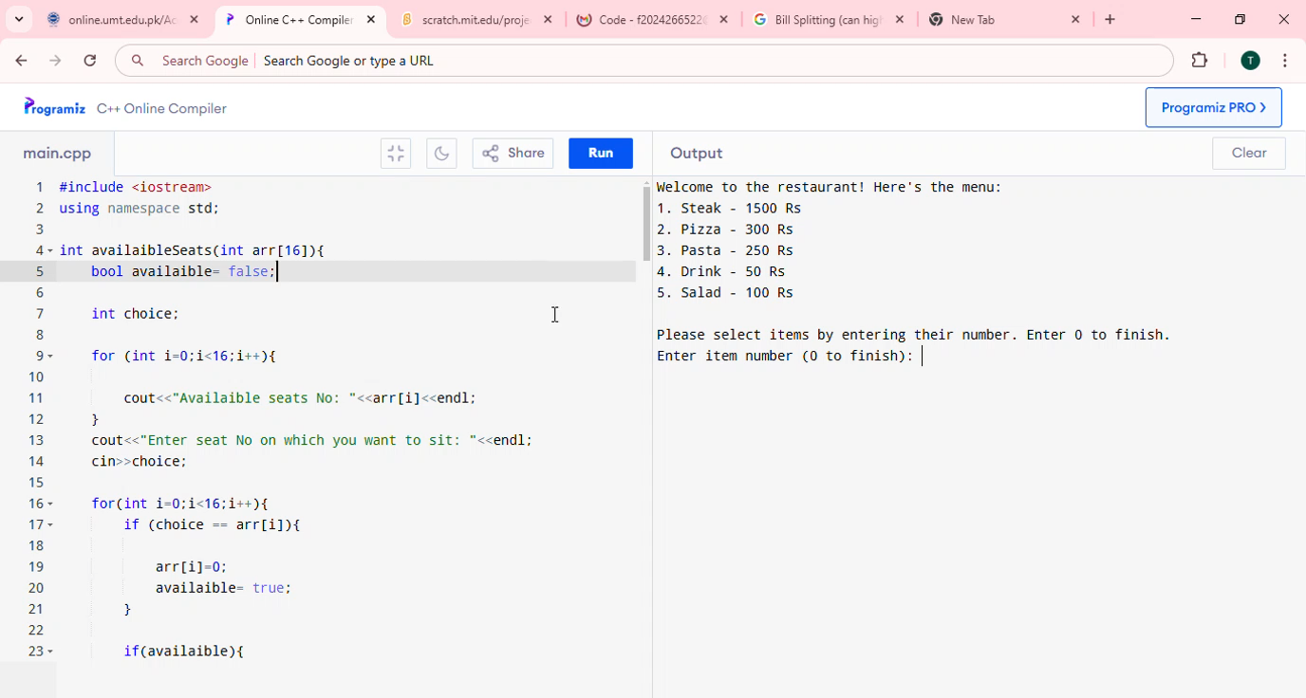

Slide 6
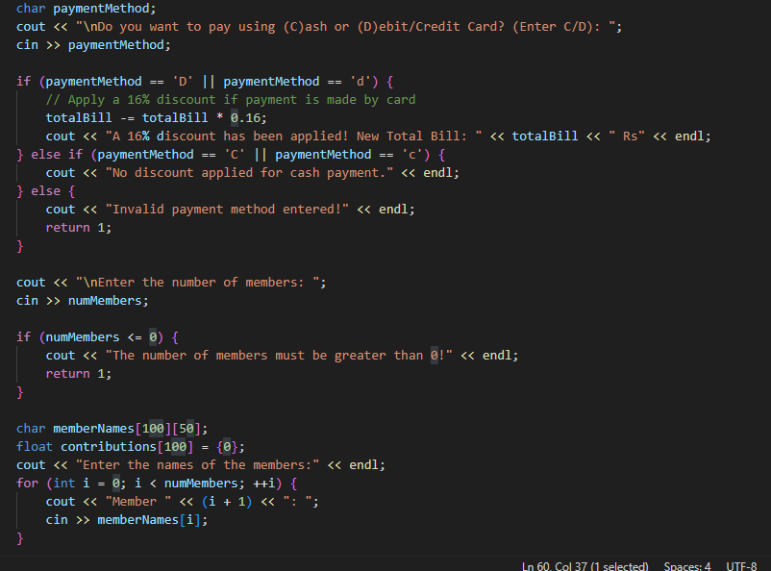
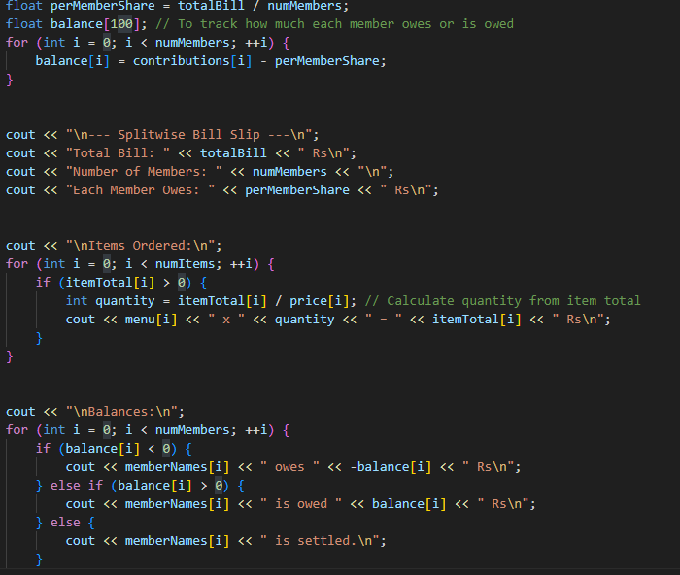
Code snippets

Slide 7

Bye!

